Slide 1
X86 Processor Architecture
Notes prepared for comp7615
Select slides adapted from “Assembly Language for x86 Processors”, 7th Edition, Kip Irvine, and comp1113 Applied Mathematics
Carly Orr, BCIT

Slide 2
What's Next
X-86
64-Bit Processors

Slide 3
The 80x86
To learn AL, we need to pick a processor family (or an Instruction Set Architecture).
The 80x86 ISA (or x86) is in most of our computers
Evolved from 1970’s Intel
8086 (16-bit registers)
80286, 80386, 80486, Pentium, (32 bit registers)
I3, i5, i7 (64-bit registers)
https://en.wikipedia.org/wiki/List_of_Intel_microprocessors

Slide 4
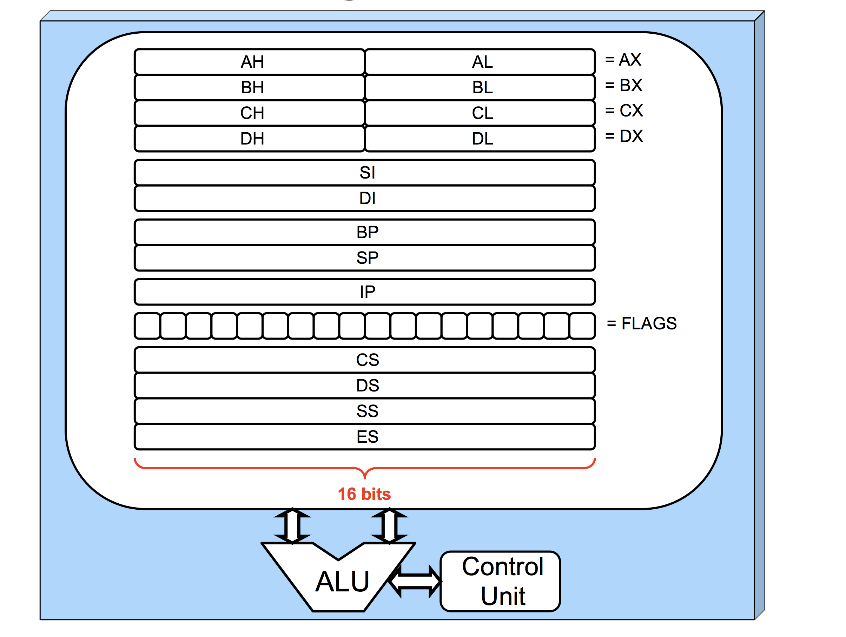
8086 16-bit registers
General purpose
Index related / general
Stack related
Segment related

Slide 5
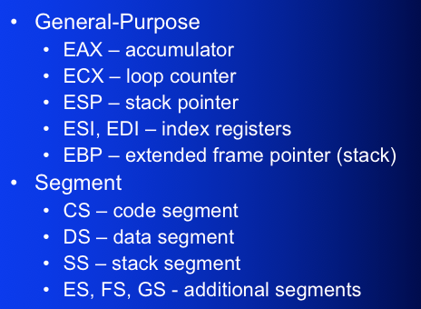
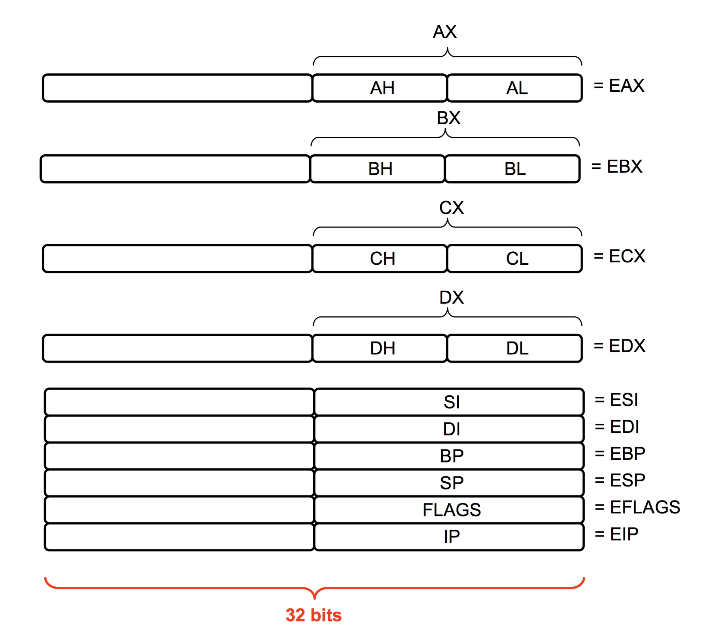
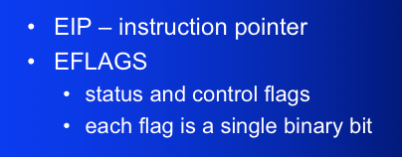
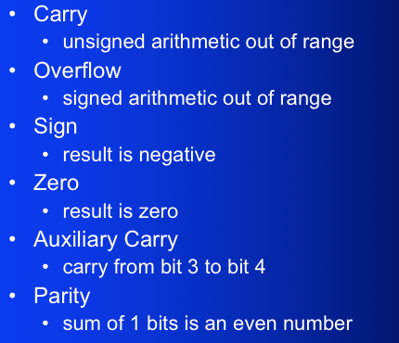
32-bit General-Purpose Registers
Named storage locations inside the CPU, optimized for speed.

Slide 6
FYI: Floating-Point, MMX, XMM Registers
Eight 80-bit floating-point data registers
ST(0), ST(1), . . . , ST(7)
arranged in a stack
used for all floating-point arithmetic
Eight 64-bit MMX registers
Eight 128-bit XMM registers for single-instruction multiple-data (SIMD) operations

Slide 7
What's Next
X-86
64-Bit Processors

Slide 8
64-Bit Processors
64-Bit Operation Modes
Compatibility mode – can run existing 16-bit and 32-bit applications (Windows supports only 32-bit apps in this mode)
64-bit mode – Windows 64 uses this
Basic Execution Environment
addresses can be 64 bits (48 bits, in practice)
16 64-bit general purpose registers
64-bit instruction pointer named RIP

Slide 9
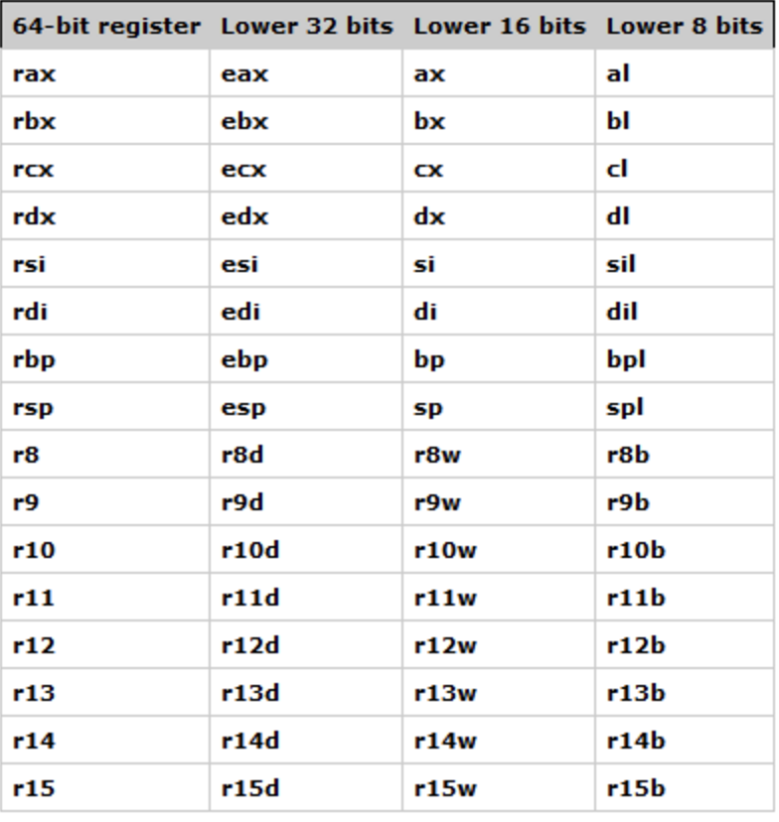
General Purpose Registers
32-bit general purpose registers:
EAX, EBX, ECX, EDX, EDI, ESI, EBP, ESP, R8D, R9D, R10D, R11D, R12D, R13D, R14D, R15D
64-bit general purpose registers:
RAX, RBX, RCX, RDX, RDI, RSI, RBP, RSP, R8, R9, R10, R11, R12, R13, R14, R15

Slide 10
42 69 6E 61 72 79
What does this say?
(in ASCII)

